Slide 1

C379 Emerging technologies
Lesson 17: Model Evaluation & KNN

Slide 2

L17 Learning Objectives
Evaluate machine learning models using metrics such as accuracy, precision, recall, F1-score, and mean squared error.
Describe KNN algorithms used to perform classification tasks in AI
Apply KNN algorithms to train a predictive model
Test and evaluate the KNN model

Slide 3


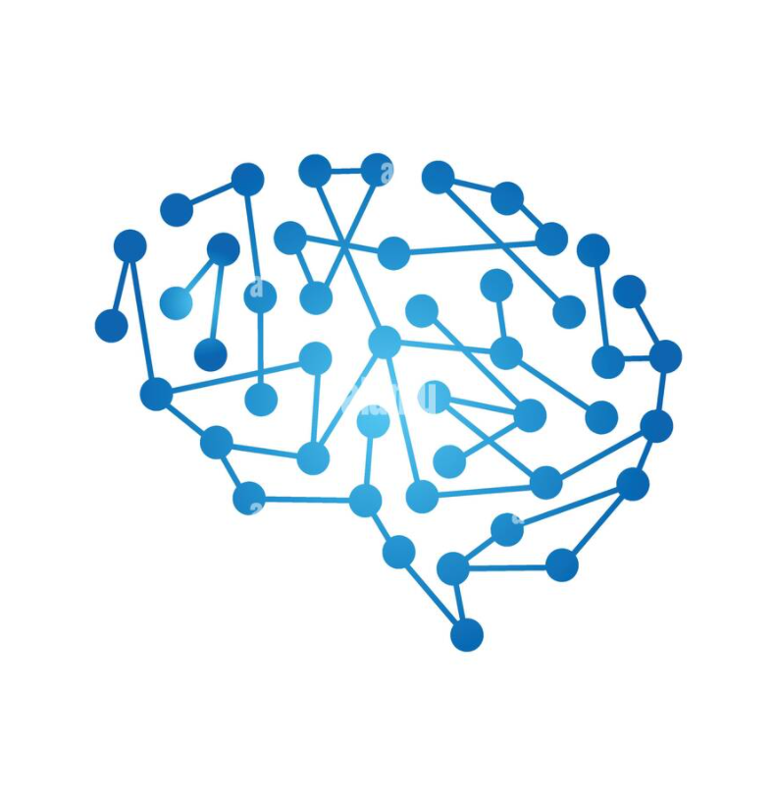
Model Evaluation

Slide 4
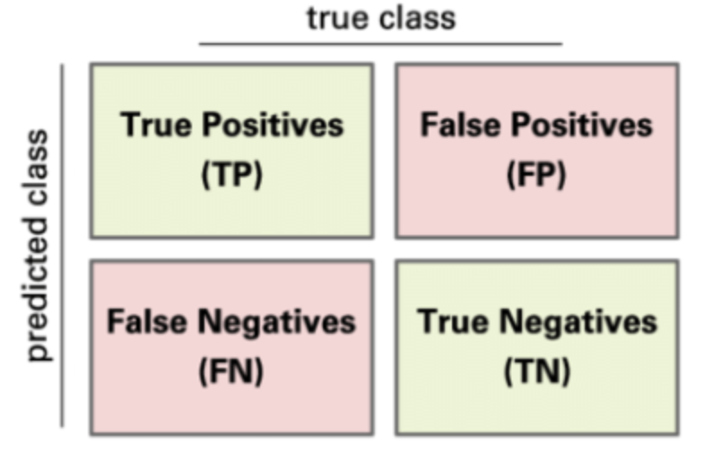
Confusion Matrix
It is a table with 4 different cases that represent the 4 possible outcomes in a binary classification problem. The model makes a correct prediction have 2 possible cases:
True Positive (TP): The model predicts the positive class and the observation actually belongs to the positive class.
True Negative (TN): The model predicts the negative class and the observation actually belongs to the negative class.

Slide 5
Confusion Matrix
On the other hand, when the model makes a mistake, again 2 possible cases can be happening:
False Positive (FP): The model predicts the positive class and the observation actually belongs to the negative class.
False Negative (FN): The model predicts the negative class and the observation actually belongs to the positive class.

Slide 6
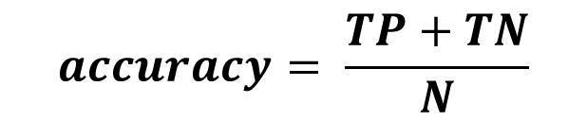
Performance Metrics
There are some metrics that you can calculate to make more sense of these numbers above. The following are some of the most important metrics we can get from the quantities observed in the confusion matrix:
Accuracy: Proportion of cases correctly identified by the classifier (N represents the total number of observation in the testing dataset):
$$accuracy= \frac{TP+TN}{N}$$

Slide 7
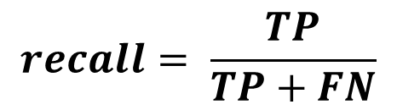
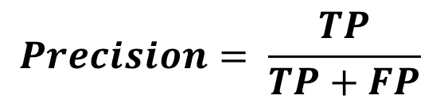
Performance Metrics
Precision: Proportion of correct positive predictions. In this problem, this is the proportion of cases when the model is correct when it predicts defaults:
Recall (or Sensitivity): Proportion of observed positives that were predicted correctly as positives. In this problem, this is the proportion of actual defaults that the model can correctly identify:
$$Precision= \frac{TP}{TP+FP}$$
$$recall= \frac{TP}{TP+FN}$$

Slide 8
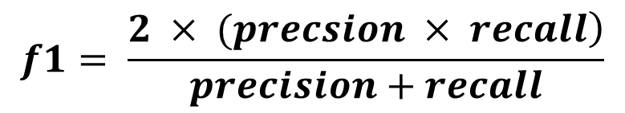
Performance Metrics
F1 Score (or balanced F-score or F-measure): It can be interpreted as a harmonic mean of the precision and recall, where an F1 score reaches its best value at 1 and worst score at 0. The relative contribution of precision and recall to the F1 score are equal.
The formula for the F1 score is:
These 4 metrics will help you understand which types of mistakes the model is making. So, let’s calculate the accuracy, precision, recall and F1 Score for your 3 predictive models.
$$f1= \frac{\left.2 × (precsion × recall\right)}{precision+recall}$$

Slide 9
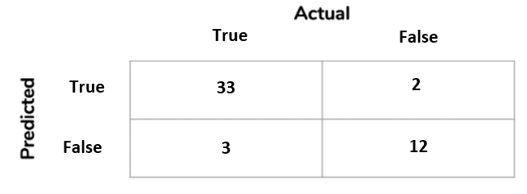
Performance Metrics
Recall (Sensitivity) = TP/(TP+FN)
= 33/(33+3)
= 0.92
Precision = TP/(TP+FP)
= 33/(33+2)
= 0.94
Accuracy = (TP+TN)/N
= (33+12)/(33+2+3+12)
= 0.9
F1 Score = (2*Precision*Recall)/(Precision + Recall)
= (2*0.94*0.92)/(0.94+0.92)
= 0.93

Slide 10
Model Building
Part 4 – Understanding KNN

Slide 11
K-Nearest Neighbours (KNN)
KNN (k-nearest neighbours) method can be used for both regression and classification
It belongs to the class of non-parametric* models, hence the predictions are not based on the calculation of any parameters.
KNN is also known as a lazy algorithm. It means it does not need any training data points for model generation.
Despite its simplicity, it frequently produces good results.
* The term non-parametric means there is no assumption for underlying data distribution. In other words, the model structure is determined from the dataset.

Slide 12
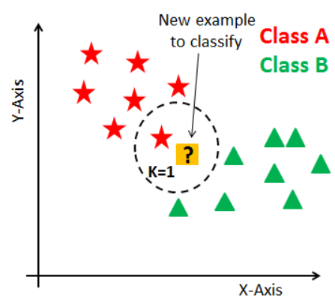
KNN – How the Algorithm works?
For a fixed number, K, which is the number of neighbours, and a given observation whose target value we want to predict, do the following:
Find the K data points that are closest in their feature values to the given data point
Calculate the average target value for those K data points
That calculated average is the prediction for the given data point

Slide 13
Binary vs Multiclass Classifications
Binary classification is when there are only two possible outcomes like a person is infected with COVID-19 (outcome =1) or is not infected with COVID-19 (outcome=0).
In multi-class classification, there are multiple outcomes like the person may have the flu or an allergy, or cold or COVID-19.

Slide 14
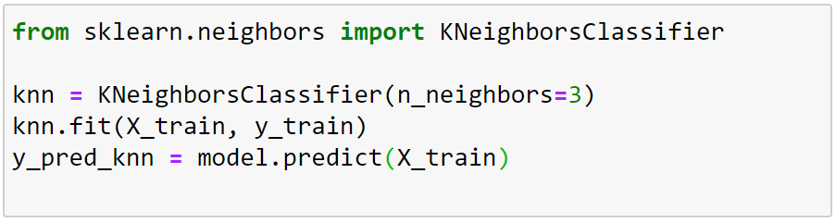
KNN Classifier
1. Importing KNN method from scikit-learn framework
2. Calling the KNN method with the number of neigbours = 3
3. From the training dataset and labels provided in the parameters, the KNN method train the model to make prediction.
4. The predict method is used to classify incoming data point
X_train matrix contains all the features of the training set
y_train matrix contains the label from the training set

Slide 15
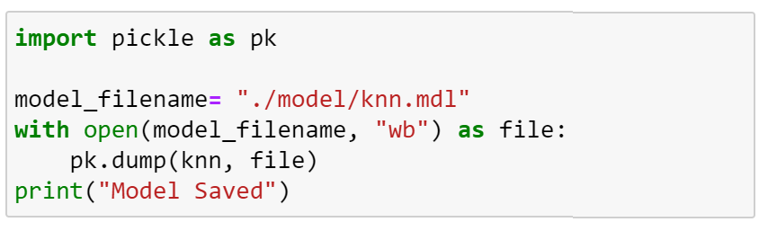
Saving A Predictive Analytics Model
1. Importing pickle method to serialize and de-serialize a Python object structure
2. Open a binary file and write the pickled representation of the AI model into it

Slide 16

Lab Demonstration
Lab 17-1
Using a Simple KNN Model

Slide 17
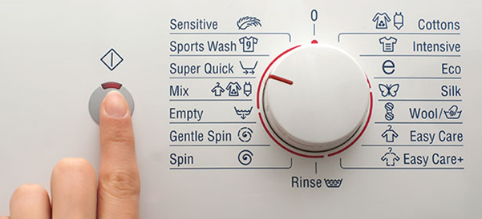
Recall from L01: Where can AI be applied?
Let’s zoom in on the problem statement
……….
The challenge with existing appliances from current consumer electronic companies lies in the fact that they are closed-systems
……….
To ascertain
(i) availability or
(ii) estimated time before availability, ………
(iii) update at what stage of the washing or drying programme that the appliance is in is desirable.
……….
Closed-systems
NO explicit data is sent or received by the washing machine to provide any information of status
Status must be deduced based on indirect data, e.g. power consumption
X
X

Slide 18
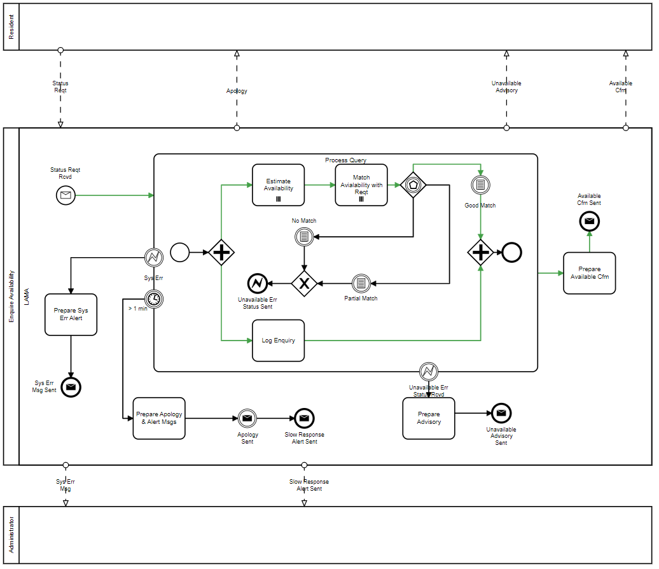
Enquire Availability, Application of AI
An AI solution can be created to estimate
when (date/time) the machine(s) will be available and determine how closely the requests can be met

Slide 19
Problem Solving
Applying KNN

Slide 20

Practical
Lab 17-2
Building A KNN Model to Solve Laundromat Problem

Slide 21
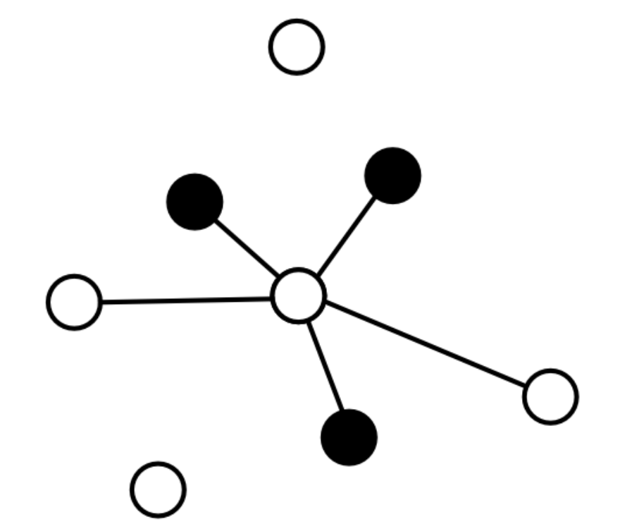
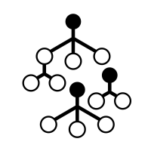
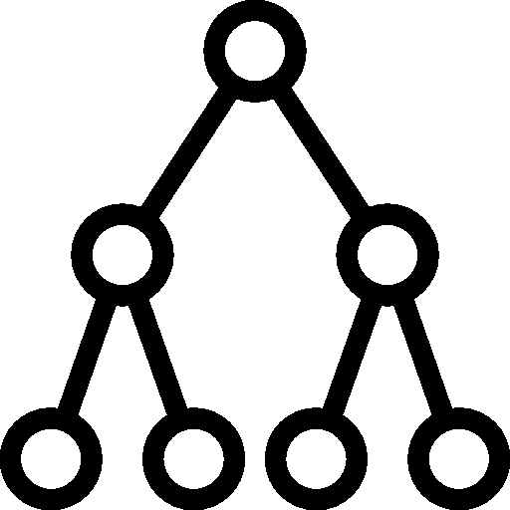
Unscheduled Asynchronous e-learning
Watch the following videos before Lesson 18:
Decision Tree - https://www.youtube.com/watch?v=7VeUPuFGJHk
60 mins

